Slide 1
What is Deep Learning, Machine Learning and Reinforcement learning . The difference of them?
Tumurbaatar Batgerel
2019-08-12

Slide 2
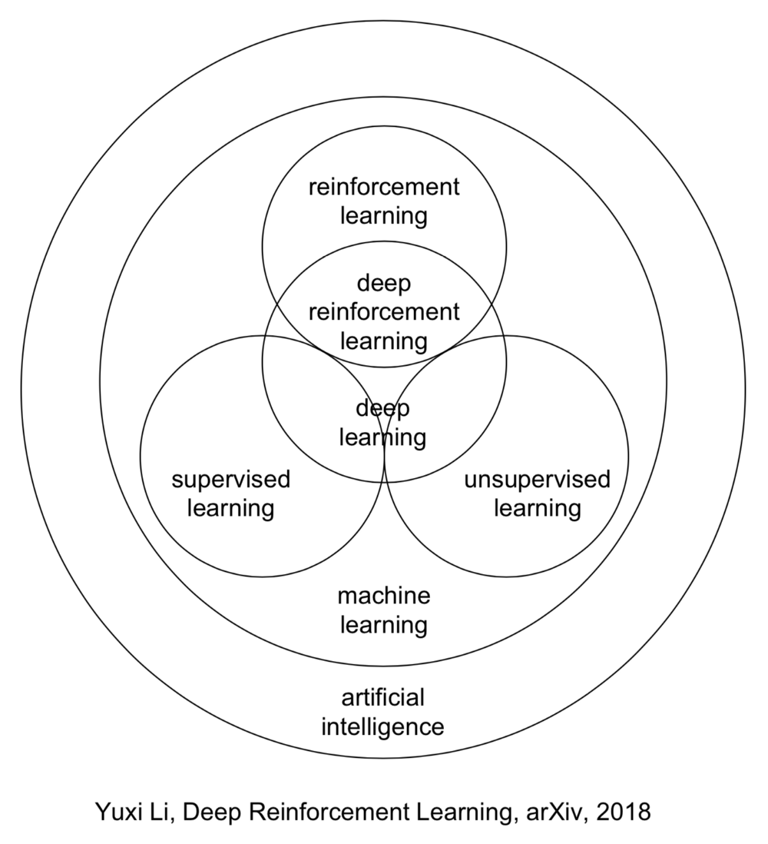


Slide 3
AI: Artificial intelligence
Artificial intelligence (AI) is the simulation of human intelligence processes by machines, especially computer systems.
AI can be categorized as either weak or strong.
Weak AI, also known as narrow AI, is an AI system that is designed and trained for a particular task. Virtual personal assistants, such as Apple's Siri, are a form of weak AI.
Strong AI, also known as artificial general intelligence, is an AI system with generalized human cognitive abilities. When presented with an unfamiliar task, a strong AI system is able to find a solution without human intervention.
Notes:
These processes include learning (the acquisition of information and rules for using the information), reasoning (using rules to reach approximate or definite conclusions) and self-correction.

Slide 4
AI deals with the following issues
Reasoning and Problem Solving
Knowledge representation
Planning
Learning
Perception
Motion and Manipulation
Social Intelligence
General Intelligence
Machine Learning

Slide 5
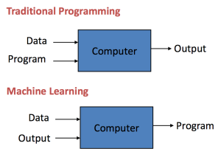
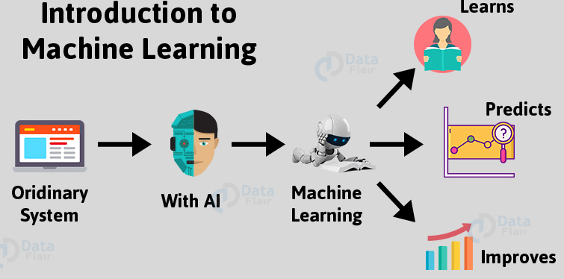
What is Machine Learning?: Machine Learning is getting computers to program themselves
Notes:
If programming is automation, then machine learning is automating the process of automation.
Writing software is the bottleneck, we don’t have enough good developers. Let the data do the work instead of people. Machine learning is the way to make programming scalable.

Slide 6
What is Machine Learning?
Machine Learning is concerned with giving machines the ability to learn by training algorithms on a huge amount of data. It makes use of algorithms and statistical models to perform a task without needing explicit instructions.

Slide 7
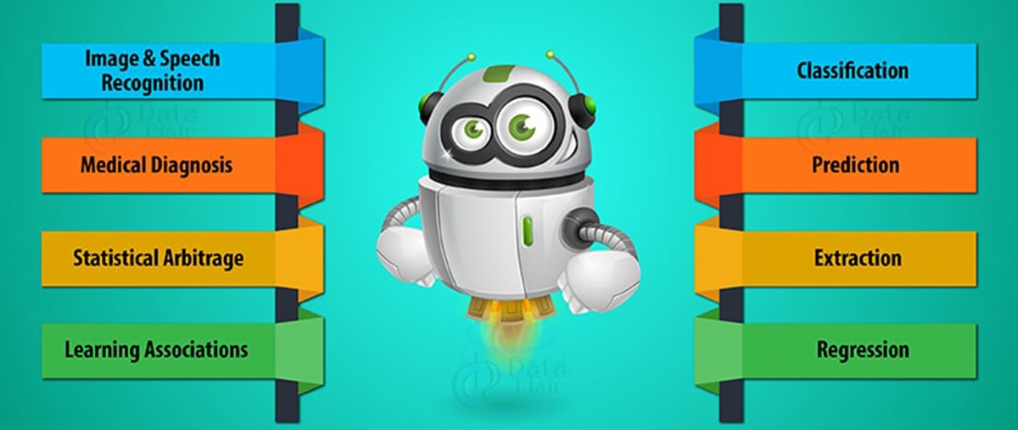
Applications of Machine Learning

Slide 8
Machine Learning often deals with the following issues:
Collecting data
Filtering data
Analysing data
Training algorithms
Testing algorithms
Using algorithms for future predictions

Slide 9
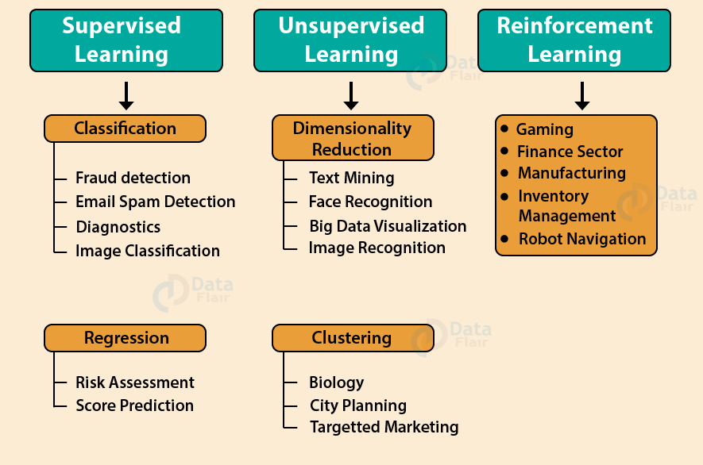
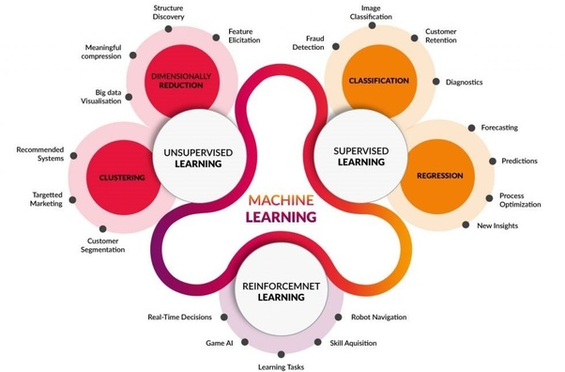
Types of Machine Learning

Slide 10

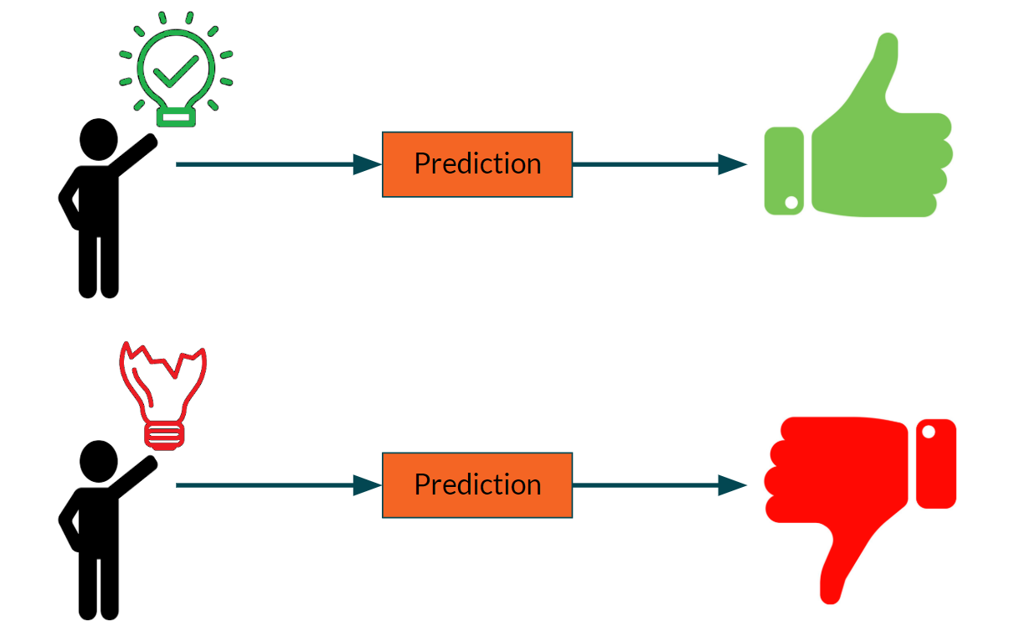



How does Machine Learning Work?
Input Data
Analyze Data
Find Patterns
Predictions
Stores the Feedback

Slide 11
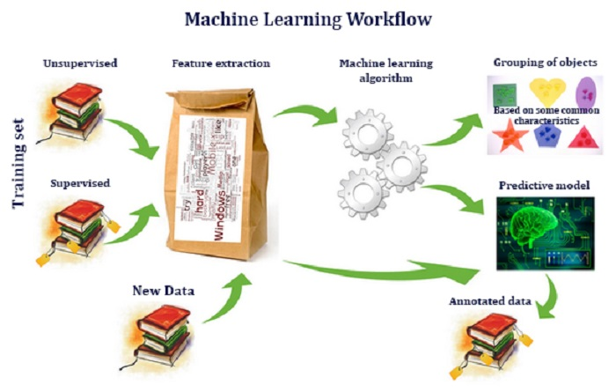

Slide 12
What is Deep Learning? (DL)
As mentioned above Deep Learning is the advanced type of Machine Learning, whereas the functioning is very similar, yet the capability of Deep Learning is quite different.
Machine Learning tools and techniques are the two key narrow subsets. That only focuses more on deep learning.

Slide 13
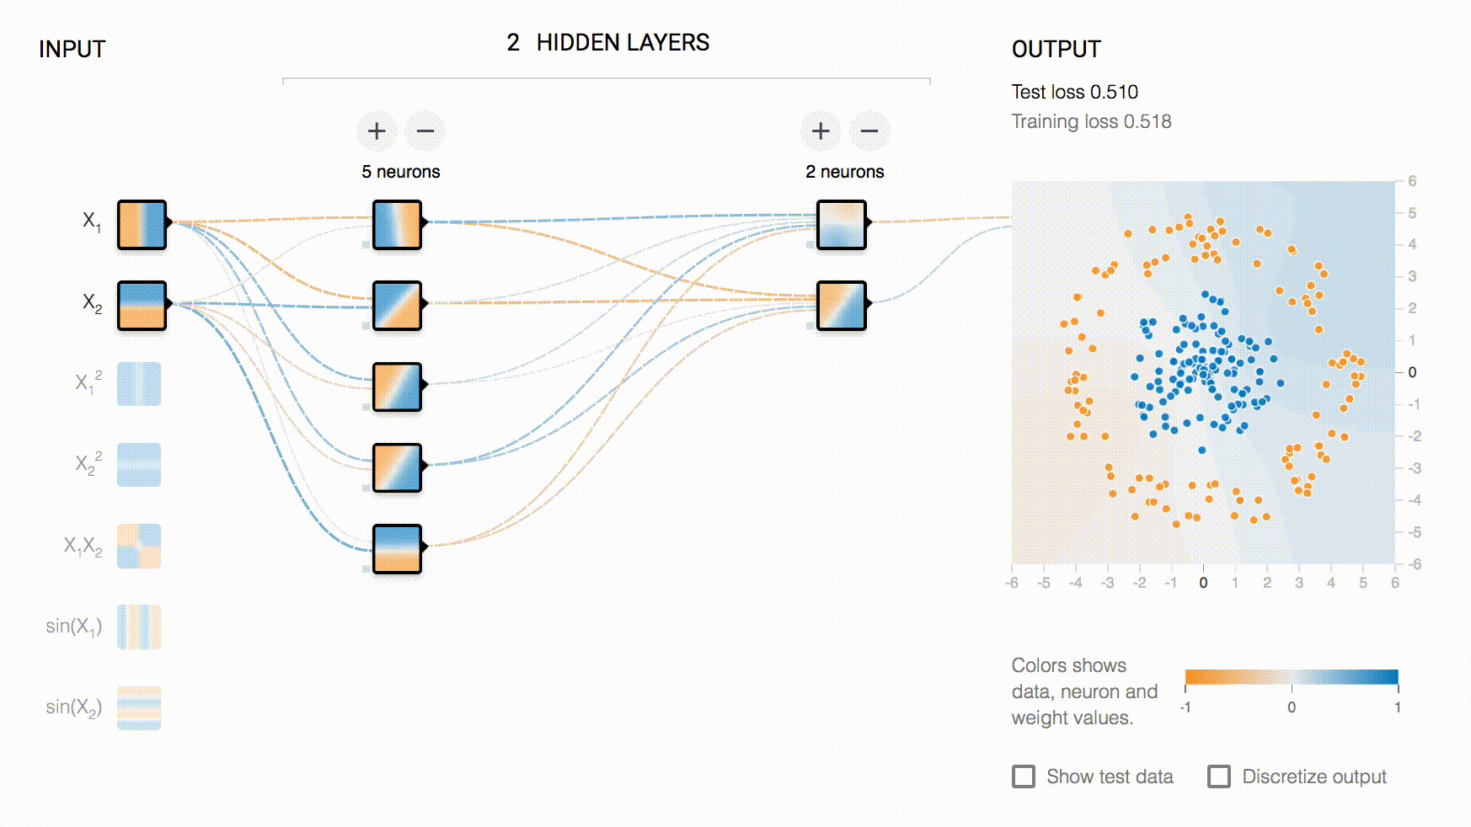
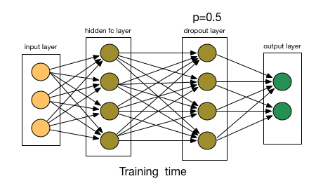
What is Deep Learning?

Slide 14
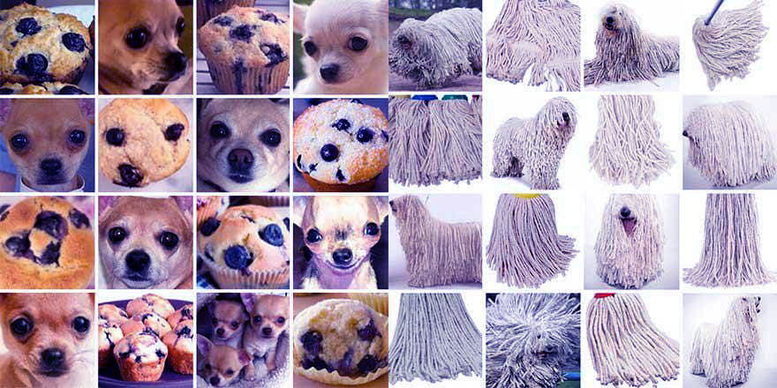
Image recognition

Slide 15
I. Pretraining and Model

Slide 16
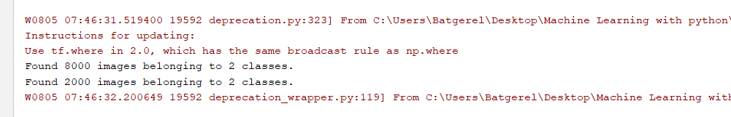
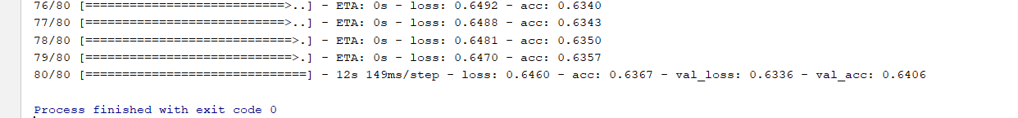
II. Image Classifier process

Slide 17
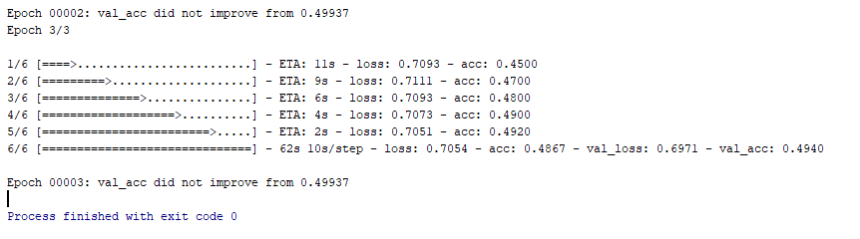
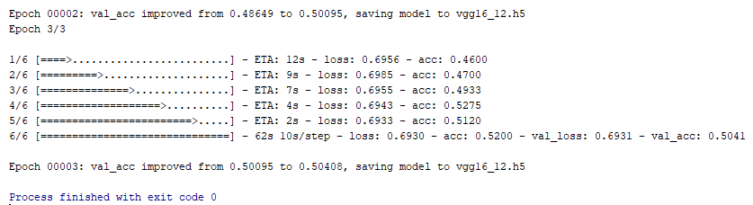
III. DL() Learning process

Slide 18
IV. Transfer weight

Slide 19
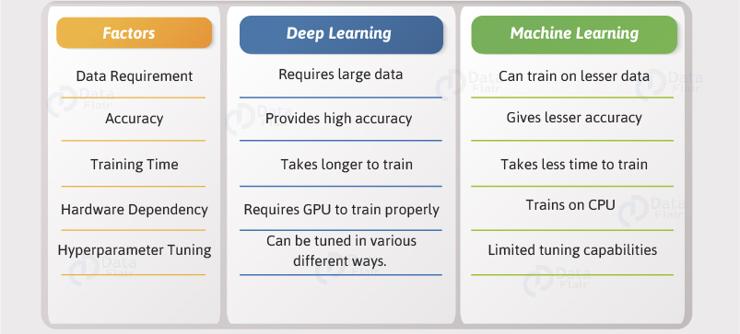
Deep learning VS Machine Learning

Slide 20
Reinforcement Learning ? (RL)
Reinforcement Learning is an emerging and most popular type of Machine Learning Algorithm.
It is used in various autonomous systems like cars and industrial robotics.

Slide 21
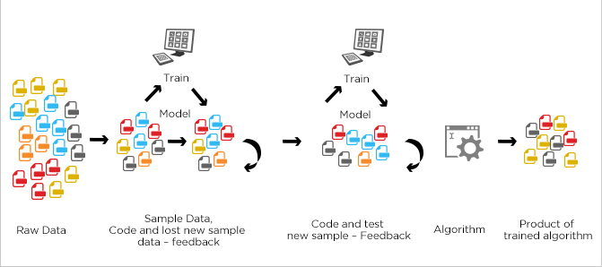
Reinforcement Learning ? (RL)
Optimal Value Functions

Slide 22
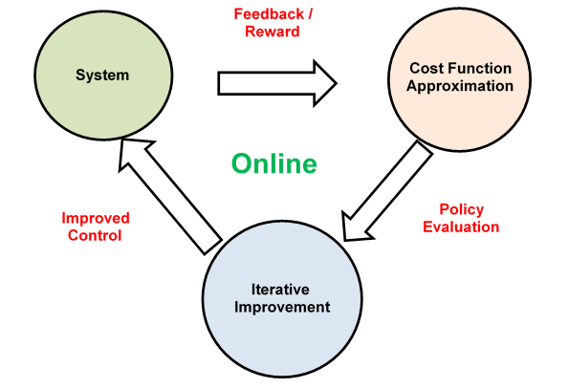
Workflow
Reinforcement learning is an autonomous, self-teaching system that essentially learns by trial and error.
It performs actions with the aim of maximizing rewards, or in other words, it is learning by doing in order to achieve the best outcomes.
In other hand reworking and modifying its algorithms autonomously over many iterations until it makes decisions that deliver the best result.

Slide 23
Difference between Deep Learning and Reinforcement Learning
Deep learning and reinforcement learning are both systems that learn autonomously.
The difference between them is that deep learning is learning from a training set and then applying that learning to a new data set, while reinforcement learning is dynamically learning by adjusting actions based in continuous feedback to maximize a reward.

Slide 24
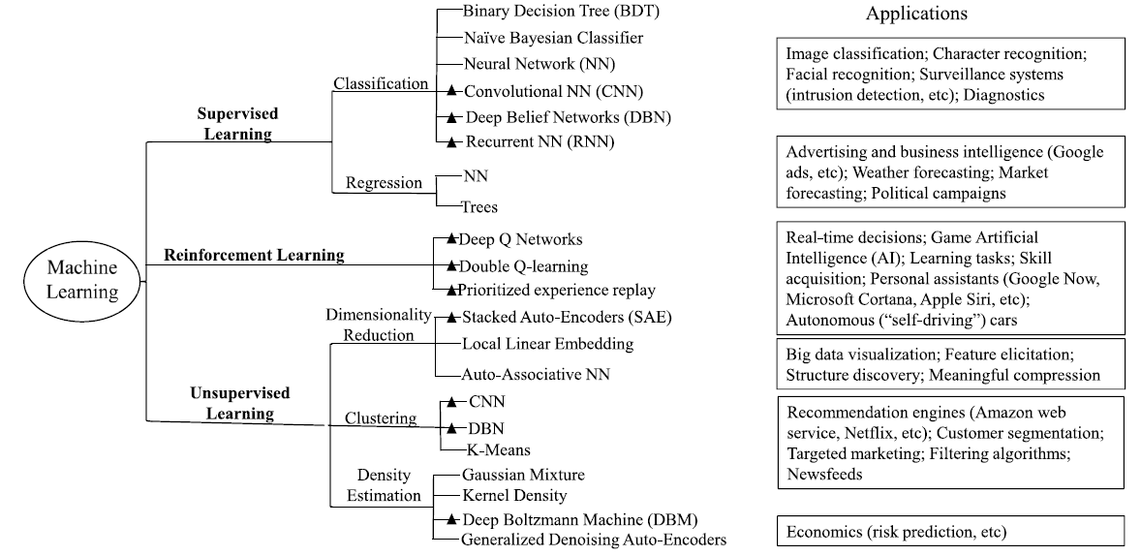
Conclusion
Deep learning

Slide 25
Deep Learning

Slide 26
How self-driving cars work
AI technologies power self-driving car systems. Developers of self-driving cars use vast amounts of data from image recognition systems, along with machine learning and neural networks, DEEP LEARNING to build systems that can drive autonomously.
The neural networks identify patterns in the data, which is fed to the machine learning algorithms.
That data includes images from cameras on self-driving cars from which the neural network learns to identify as traffic lights, trees, curbs, pedestrians, street signs and other parts of any given driving environment.

